Slide 1
FUTURE FORMS
Caterina Ines Latella

Slide 2
INDEX
FUTURE TIME EXPRESSIONS
BE GOING TO + INFINTIVE
PRESENT CONTINUOUS (with future meaning)
WILL/WON’T + INFINITIVE
PRESENT SIMPLE

Slide 3
FUTURE TIME EXPRESSIONS
Time expressions that usually go with the FUTURE FORMS are:
TOMORROW
NEXT +____(week/month/year/summer, etc…)
IN + ________ (future month/year): In June/In 2019
IN __2 weeks/years___ TIME
ON + ________ (future weekday): On Monday (only if today is Sunday )
SOON / LATER/ IN THE NEAR FUTURE/ THIS AFTERNOON etc…

Slide 4


Be + going to + infinitive
For FUTURE PLANS – I am going to see my friends /I am not going to see my friends
For INTENTIONS - We are going to get married soon / We aren’t going to get married soon
For PREDICTIONS – It is going to rain tomorrow / It isn’t going to rain tomorrow
  More examples
I am going to study this afternoon (this is my plan for the afternoon)
I am going to study hard this year (this is my new year’s resolution)
I am going to be a doctor (it is my prediction for the future)

Slide 5




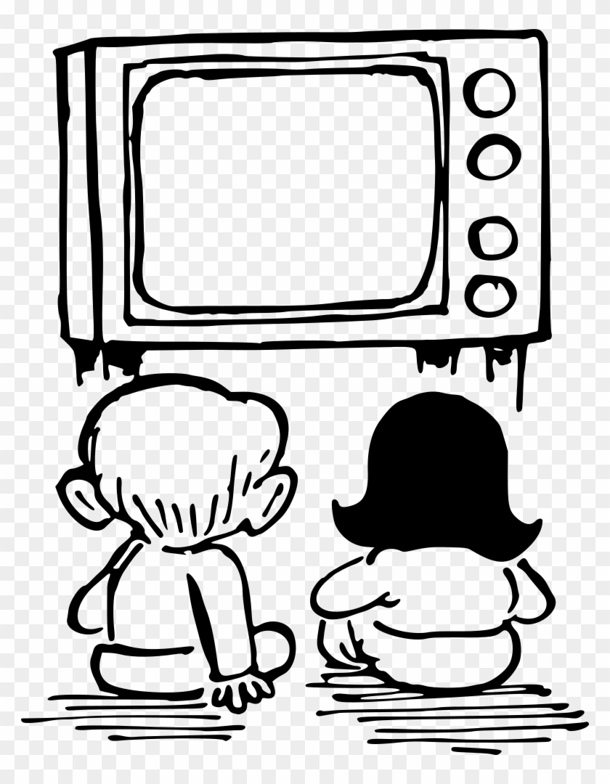
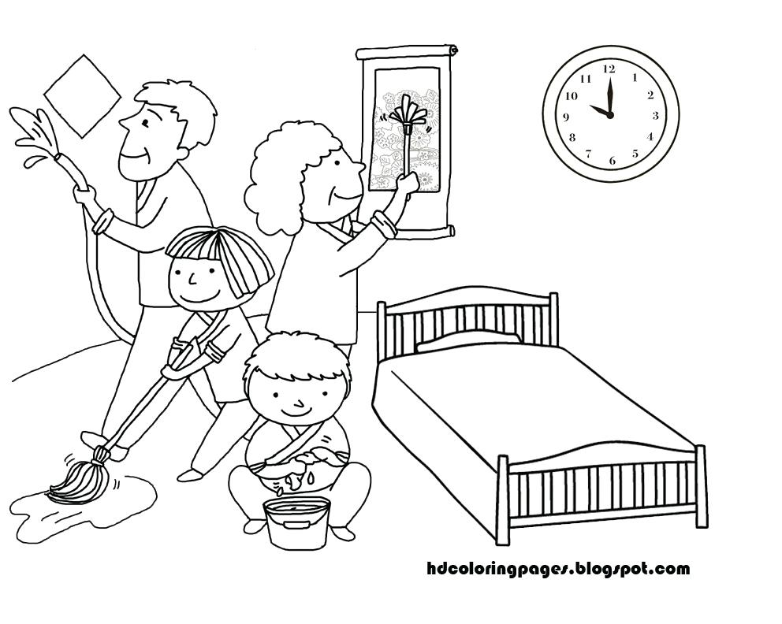

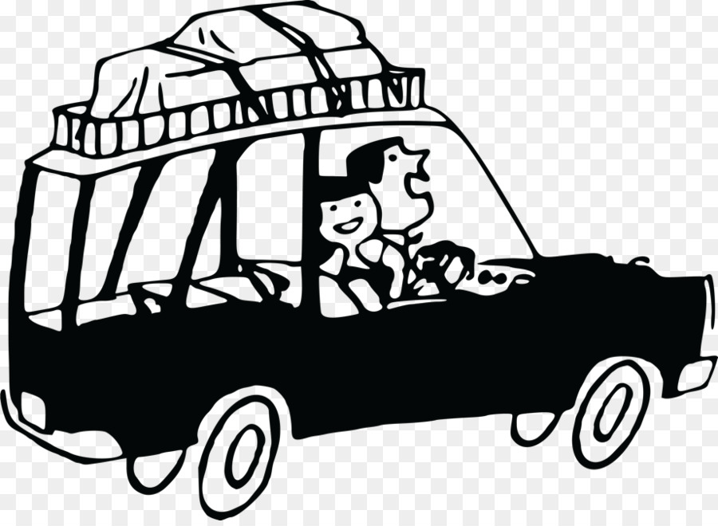

So, What are you going to do at the weekend? WHAT ARE YOUR PLANS / INTENTIONS?

Slide 6
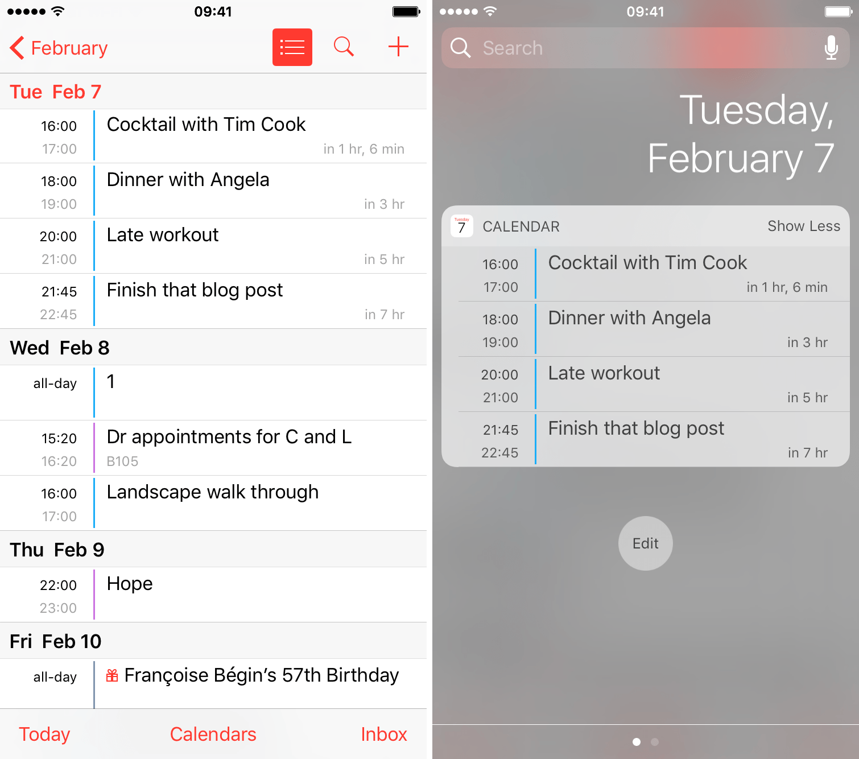

PRESENT CONTINUOUS
For FUTURE ARRANGEMENTS /əˈreɪndʒ.mənt/
Ex. I am seeing the doctor on Wednesday 8th
FIXED PLACE OR TIME !

Slide 7
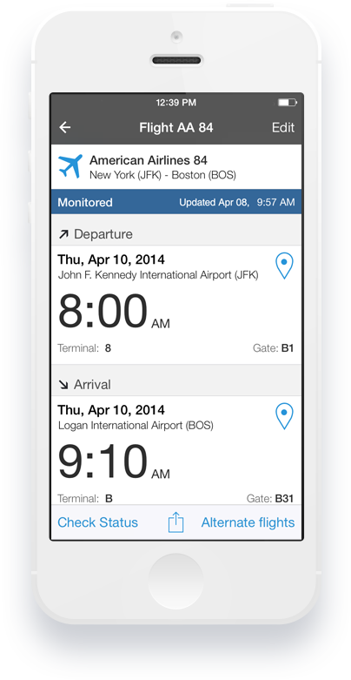
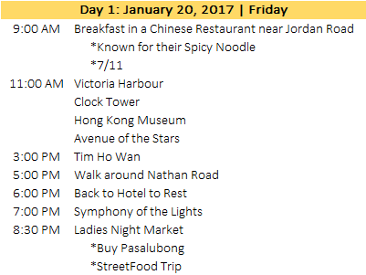
Travel Intinerary /

Slide 8
PRESENT CONTINUOUS - PRACTICE
Which of the sentences in each pair has a future meaning?
a. Are you going to fix the computer?
b. Are you fixing the computer?
2. a. In tomorrow’s class, the teacher is explaining the future forms.
b. The teacher is explaining the future forms. Right now he is assigning a task.
a. Sheila is going to cook pizza for dinner tonight.
b. Sheila cooks pizza for dinner every Friday night.
a. Oh, no! Steve is putting paprika into the soufflé. Stop him!
b. Steve is making onion soufflé later.
a. First, Sean is going to cut up the chicken. Then he is going to season it with paprika and garlic.
b. Now Sean is cutting up the chicken and seasoning it with paprika and garlic.
a. We don’t usually work on Monday mornings.
b. We aren’t working on Monday morning.
a. “Where are you going now?” “I’m going home.”
b. “What are you going to do later?” “I am going to bake a lemon cake.”

Slide 9

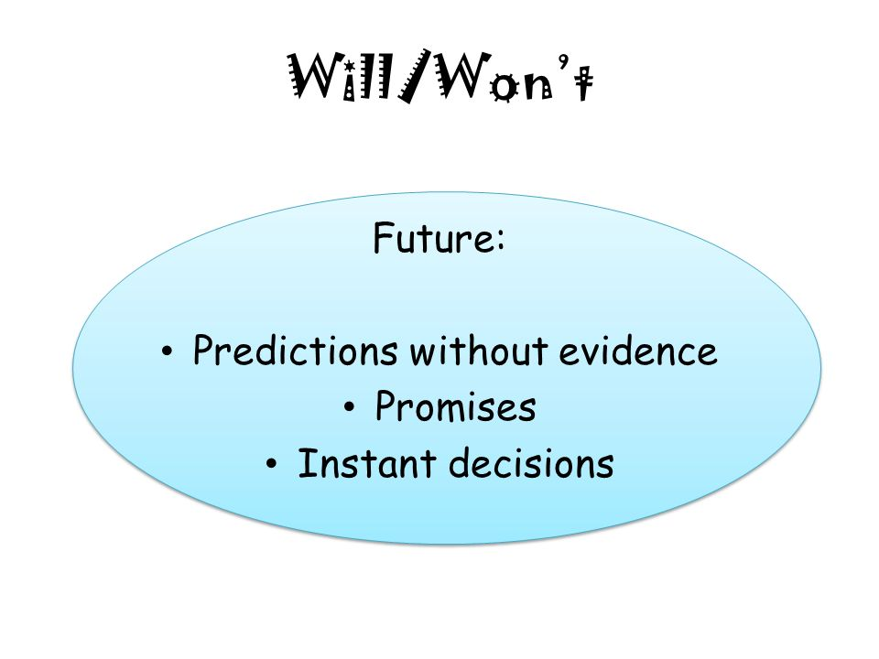


WILL / WON’T
She will finish it later
The boss won’t be late
It will take a minute
I’ll have a beer and a salad (at the restaurant)
I can tell you, once it is finshed you’ll be satisfied

Slide 10
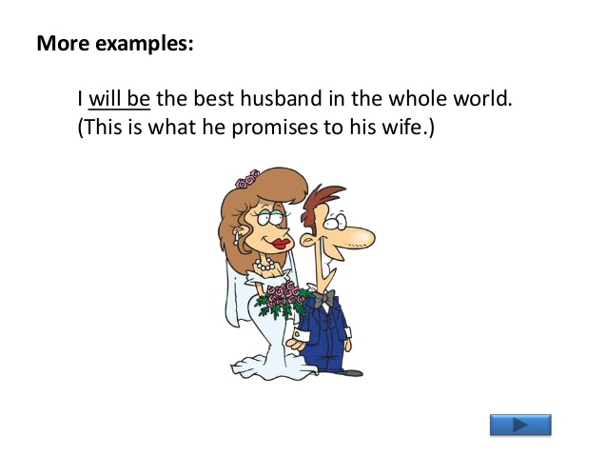
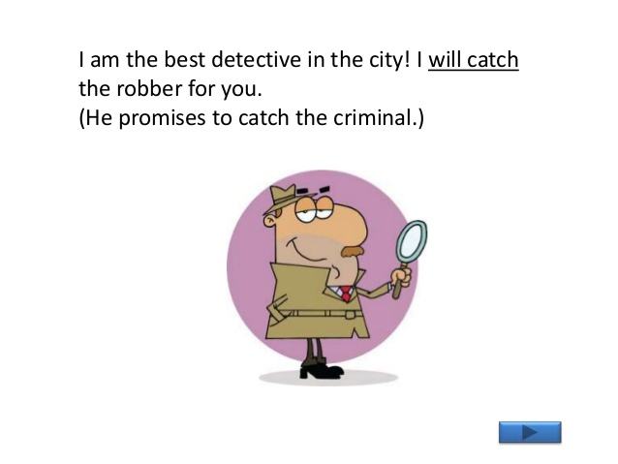
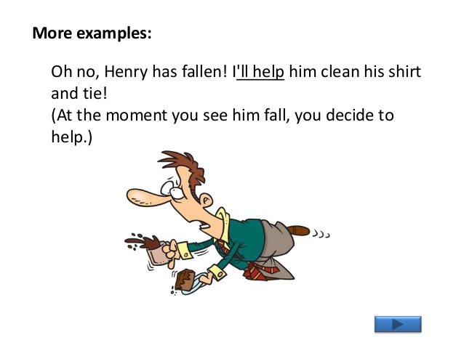
WILL / WON’T

Slide 11
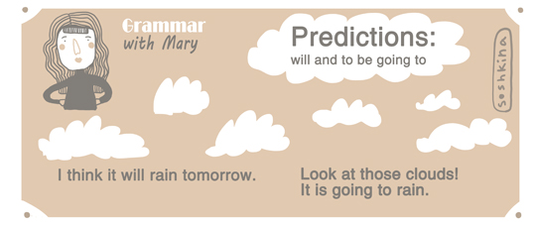
Future predictions: be going to OR WILL?

Slide 12
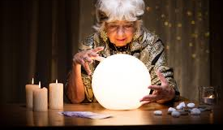
Future predictions: be going to OR WILL?
I THINK YOU’LL BE FAMOUS
I DON’T THINK YOU’LL BE FAMOUS

Slide 13
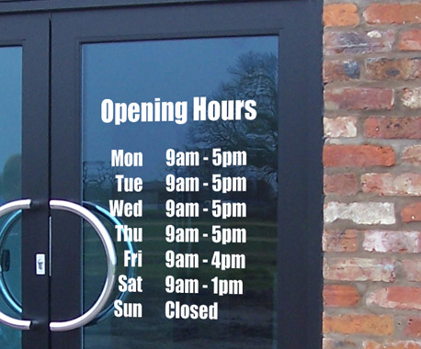
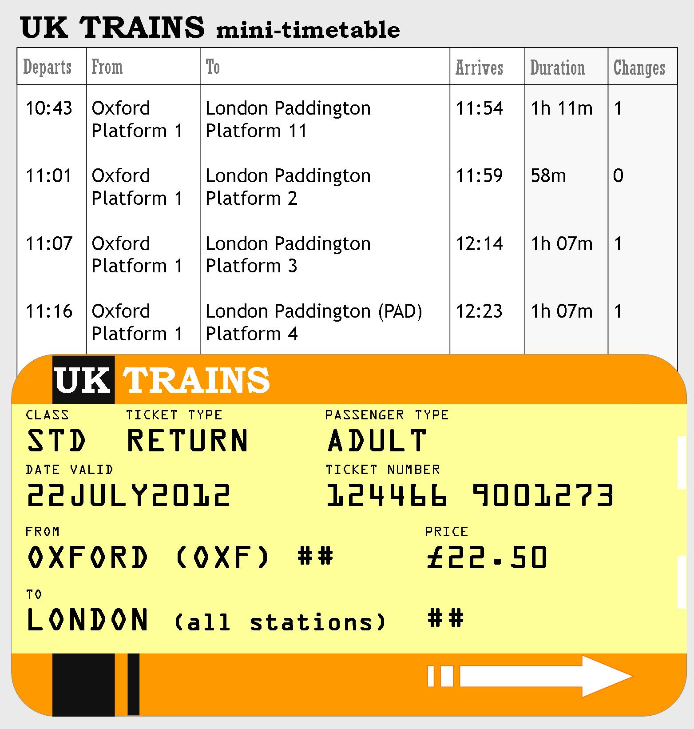
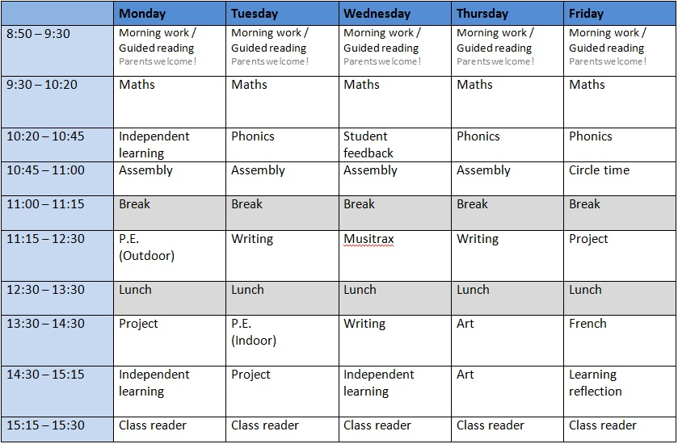
TIMETABLES AND OPENING HOURS – PRESENT SIMPLE

Slide 14
FUTURE FORMS
Watch the following video to know more about the form BE GOING TO:
https://www.youtube.com/watch?v=qT5Ul3tMjDA
Some more links to revise and practice:
https://learnenglishteens.britishcouncil.org/grammar/intermediate-grammar/future-forms
https://learnenglish.britishcouncil.org/english-grammar-reference/talking-about-future
https://elt.oup.com/student/englishfile/intermediate/a_grammar/file01/nef_int_grammar01_c02?cc=global&selLanguage=en
https://elt.oup.com/student/englishfile/intermediate/a_grammar/file01/nef_int_grammar01_c01?cc=global&selLanguage=en
https://elt.oup.com/student/result/engpreint/a_grammar/unit12/12c_1?cc=global&selLanguage=en
https://elt.oup.com/student/result/engpreint/a_grammar/unit12/12c_2?cc=global&selLanguage=en

Slide 15
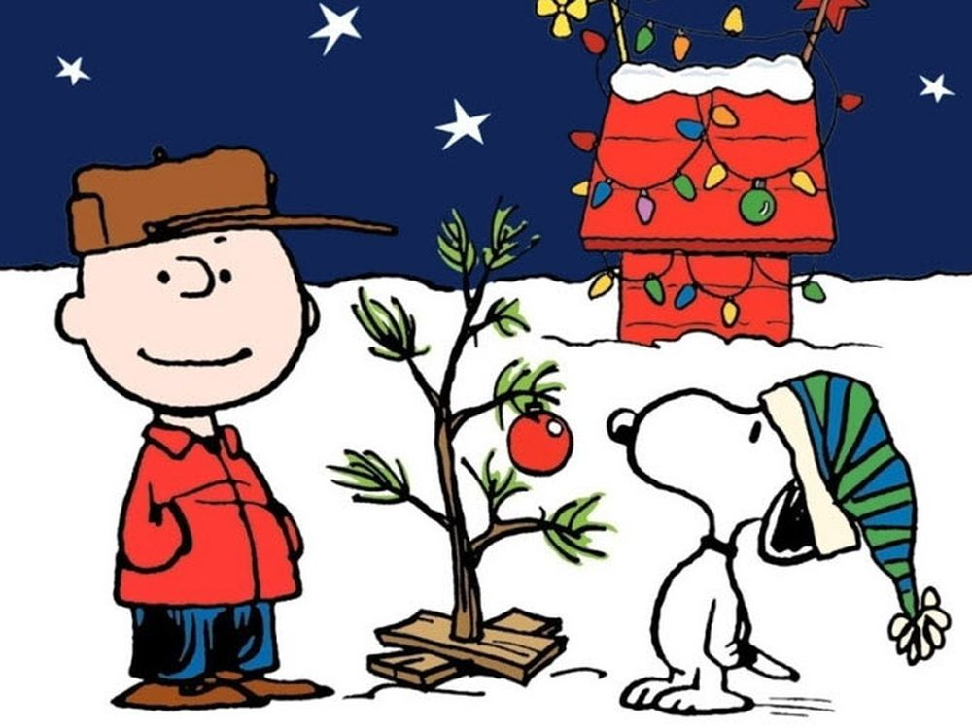
FUTURE FORMS

Slide 16

THANK YOU FOR YOUR attention

